Slide 1
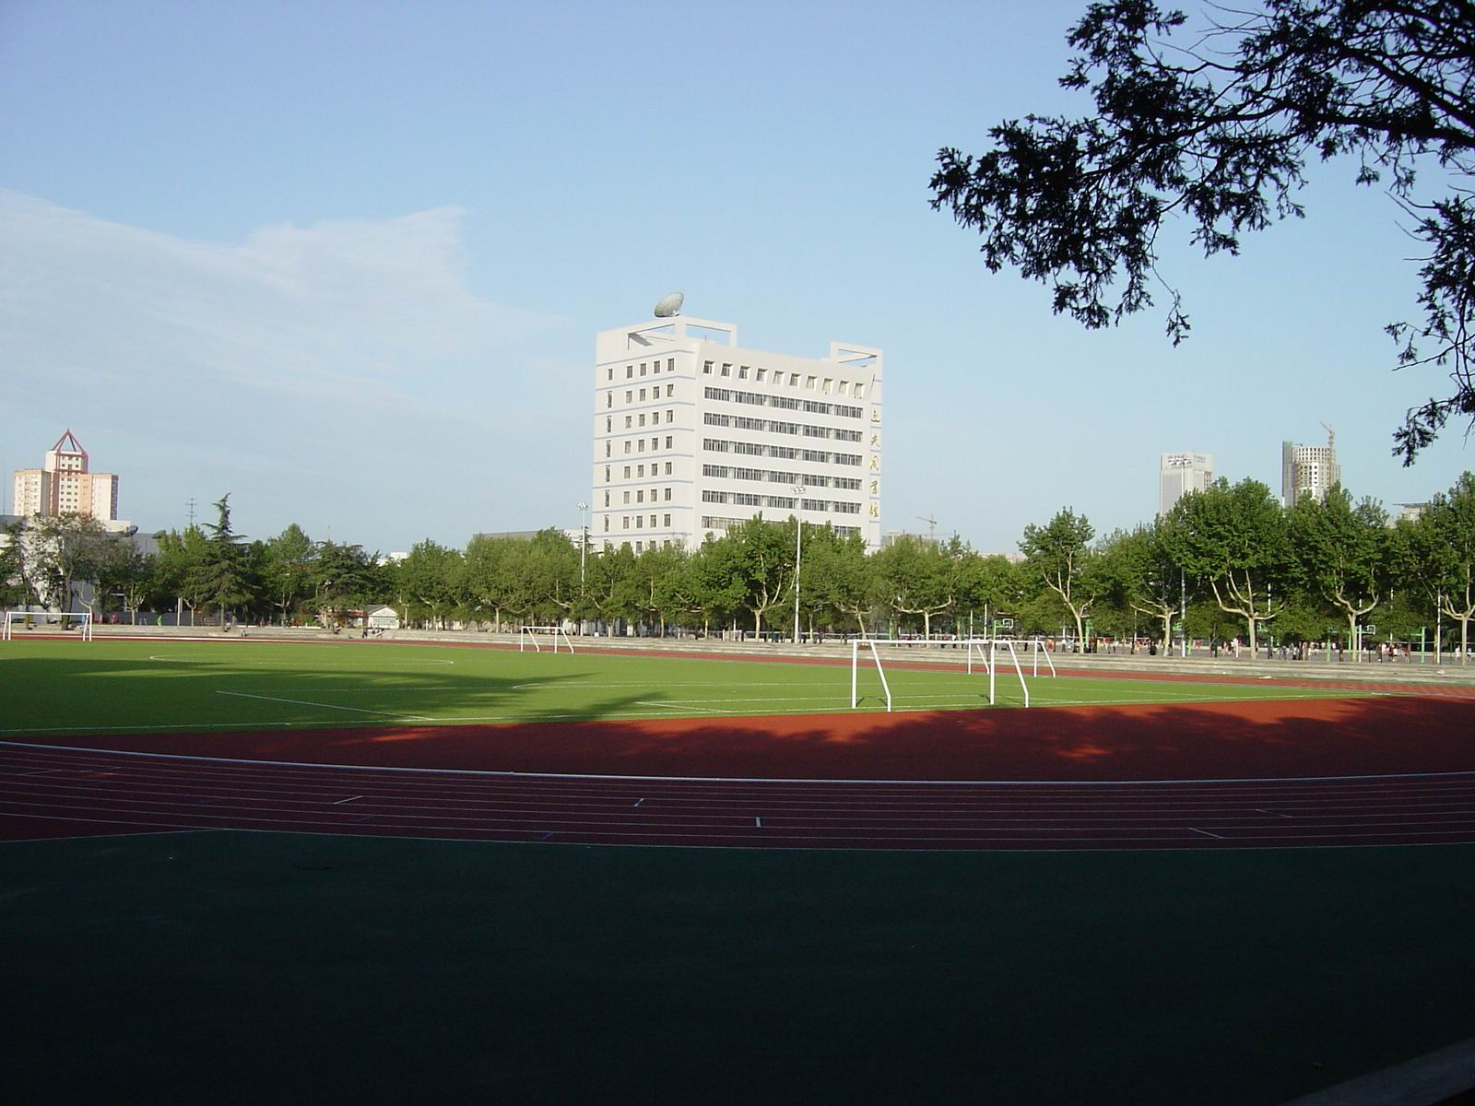
Welcome to all of you for learning together with Me!
(after two years from today, various flowers are blooming.)

Slide 2
software defined networking and virtualization
Instructor:
Dr. Zhanqi XU
Zqxu@mail.xidian.edu.cn
National Key Lab on ISN,
Xidian University
Notes:
The course is entitled software defined networking and virtualization , I am the instructor from National Key Lab on ISN,
Xidian University. Every one could access to me with Zqxu@mail.xidian.edu.cn.

Slide 3
Course Description:
This course provides an introduction to the networking basics, the hot topics of software defined networking (SDN) with network function virtualization (NFV), and other topics seminar, plus with practical experimental experiences that may be unavailable in this unusual moment.

Slide 4
Goals of the course:
Recognize the importance of the abbreviation of professional words (or networking communication language) and networking architecture. Such as, what are the relations between SDU and PDU?
Master the technical aspects of the Motivation of SDN/NFV, principles and architecture, mains protocols, networking applications, research issues, R&D platforms, etc.
Increase your comprehensive skill through seminar.
Make you closer to SDN by establishing a small SDN videophone experiment in my Lab.

Slide 5
Not the goal of the course:
Comprehensive knowledge about networking techniques, including basic networking concept, protocol, architecture, control, management, etc.
Prerequisite course :
Communication network, computer network, basic networking, or equivalence
For those who did not learn the courses above, it is mandatory to learn it right now.
Notes:
Due to the limited course time , the followings are not the goals of this course.
However, to make you have a better mastering this course, I suggest the prerequisite course

Slide 6
Contents of the course:
Chapter one
networking basics and trend
Chapter two
SDN related protocol and architecture, openflow, networking application
Chapter three
Virtualization ( architecture, networking application)
techniques, including basic networking concept, protocol, architecture, control, management, etc.
Notes:
Contents of the course are as follows/are given below/ include, are divided into three parts.

Slide 7
Practices of the course:
Assignments
Perform homework for each chapter with an induvial or each group, either give the answer of the questions or present your comments to the papers assigned.
2) Seminar
Write a Word tutorial and PPT presentation about hot cutting-edge issues, such as network softwarization or softwarized networking (there is an annual international conference entitled netsoft ), network slicing, AI-enabled networking, 5G networking, big data, cloud computing, networking and trend.
3) demo
For each group, sets up a SDN-based demonstration video phone in the Lab of integrated communication networking, which is created by myself and my colleagues.
You set up an SDN controller and control SDN switches, while Lab provides SDN Switches and IP Videophones.

Slide 8
What make this course special include:
1) Learn the usual viewpoints and the instructor’s unusual ones that are hidden behind the usual ones and are distinguished from the knowledge commonly recognized, even from famous expert;
2) Learn the cutting-edge techniques and the state-of-the-art SDN/NFV ;
3) Enhance the comprehensive ability of students through seminar and demo experiment.

Slide 9
Course materials:
Book: There is not a textbook assigned. However, I recommend some ones obtained from our library for your reference
Foundations of modern networking : SDN, NFV, QoE, IoT, and cloud / William Stallings http://williamstallings.com/Network/; 现代网络技术 : SDN、NFV、QoE、物联网和云计算 / (美) 威廉·斯托林斯等著 = 胡超, 邢长友, 陈鸣译，2018
Network function virtualization (NFV) with a touch of SDN / Rajendra Chayapathi, Syed Hassan, Paresh Shah ;网络虚拟化技术详解 : NFV与SDN / (印) 拉金德拉·查亚帕蒂, (巴基) 赛义德·法鲁克·哈萨, (印) 帕雷什·沙著 = 夏俊杰, 范恂毅, 赵辉译，2019
Software defined networks a comprehensive approach / (美) Paul Goransson, Chuck Black, Timothy Culver；深度剖析软件定义网络 (SDN) = 著 ; 王海 ... [等] 译2019
软件定义网络核心原理与应用实践（In Chinese）. 上册/下册 = / 黄韬 ... [等] 著，SDN core principles and application practice
Notes:
William Stallings is one of the most famous experts related to communication and network in the word, he wrote several books that got best reputation and have been used worldwide. I knew him through the book of “data and computer communication” when I was a postgraduate student in 1984.

Slide 10
Course materials (continued)
2) Reference: There are lots of reference materials placed on the course server via QQ 1053121288 , including two types of course-related and course basis.
3) References on the web , written by famous networking experts as below:
https://www.cse.wustl.edu/~jain, Raj Jain, Professor of Computer Science and Engineering, Washington University in St. Louis, a lots of course notes, talks, tutorials, student reports.
William stallings, who wrote several books that are honored professionally and used widely in the world. Access to him via: http://williamstallings.com/Network/
4) References searched by engines like google , never use Baidu.com to find technical material since the later may result in “draw a tiger imitating the model of a cat”.

Slide 11
Course interactions:
The exchange is available through online tools:
QQ: 1053121288 App is available at www.qq.com
Microletter: SDN&NFV
download App from www.weixin.com and scan
zqxu@mail.xidian.edu.cn
The best way access to me is to send your comments by Email.
Notes:
App for QQ is available at www.qq.com

Slide 12
Grading:
Participant or participation 10%
Assignments 40%
3) Seminar 30%
4) Demo 20%
comments:
Assignments need to be performed in English.
WORD and PPT documents of the Seminar should be written in English, and PPT could be presented in Chinese if difficulty in speaking English is encountered. However, the former is firmly encouraged and preferred.
Notes:
Your score will be determined by the following four parts.

